Slide 1


ADAMA SCIENCE & TECHNOLOGY UNIVERSITY COLLEGE OF SOCIAL SCIENCES & HUMANITIES
DEPARTMENT OF GEOGRAPHY & ENVIRONMENTAL STUDIES
Geography of Ethiopia and the Horn(GeES 101)
Credit hour: 3
Instructor: Netsanet Habtamu
netsigis.2015@gmail.com
Jan., 2022 G.C.

Slide 2
CHAPTER ONE
INTRODUCTION
  Definition, Scope and Themes of Geography
    Definition of Geography:
Note: The word Geography has been defined by different scholars differently but the accepted as a working definition is:
It is the scientific study of the Earth that describes and analyses spatial and temporal variations of physical, biological and human phenomena, and their interrelationships and dynamism
over the surface of the Earth.

Slide 3
1.1.2. The Scope, Approaches and Themes of Geography
Geography is a holistic and interdisciplinary field of study.
the scope of Geography is the surface of the Earth (atmosphere, lithosphere, hydrosphere and biosphere) which provides the habitable zone in which humans are able to live.
Note: Geography has five basic themes:
  Location:
    is defined as a particular place or position.
    Location can be of two types: absolute location and relative location.

Slide 4
Place:
  refers to the physical and human aspects of a location
  is associated with toponym (the name of a place), site (the description of the features of the place), and situation (the environmental conditions of the place).
Each place in the world has its unique characteristics expressed in terms of landforms, hydrology, biogeography etc.
Note: The concept of “place” aids geographers to compare and contrast two places on Earth.

Slide 5
Human-Environment Interaction:
  Humans have always been on ceaseless interaction with their natural environment.
No other species that has lived on our planet has a profound effect on the environment as humans.
Note: human-environment interaction involves three distinct aspects, dependency, adaptation, and modification.
Dependency: refers to the ways in which humans are dependent on nature for a living.
Modification: allowed humans to “conquer” the world for their comfortable living.

Slide 6
Adaptation: relates to how humans modify themselves, their lifestyles and their behavior to live in a new environment with new challenges.
Movement:
  entails to the translocation of human beings, their goods, and their ideas from one end of the planet to another.
    The physical movement of people allowed the human race to inhabit all the continents and islands of the world
Region:
  is a geographic area having distinctive characteristics that distinguishes itself from adjacent unit(s) of space.

Slide 7
Region can be formal Vs functional:
  a formal region that is characterized by homogeneity in terms of a certain phenomenon (soil, temperature, rainfall, or other cultural elements like language, religion, and economy).
    a functional or nodal region characterized by functional interrelationships in a spatial system defined by the linkages binding particular phenomena.
1.2. Location, Shape and Size of Ethiopia and the Horn
The Horn of Africa (eastern Africa) is a narrow tip that protrudes into the northern Indian Ocean, separating it from the Gulf of Aden.

Slide 8
It is the eastern most extension of African land (Djibouti, Eritrea, Ethiopia, and Somalia) whose cultures have been linked throughout their long history.
Note: In terms of size, Ethiopia is the largest of all the Horn of African countries, while Djibouti is the smallest.
1.2.1. Location of Ethiopia
The location of a country or a place on a map is expressed:
  Astronomical (absolute) location:
    states location of places using the lines of latitudes and longitudes.
Ethiopia is located between 3ºN (Moyale) and 15ºN (Bademe - the northernmost tip of Tigray) latitudes and 33ºE (Akobo) to 48ºE (the tip of Ogaden in the east) longitudes.

Slide 9
The east west distance (15⁰) is longer than the north-south distance (12⁰).
b) Relative location:
expresses the location of countries or places with reference to the location of other countries (vicinal), landmasses or water bodies.
  Example of Vicinal location:
    Eritrea to the north and northeast
In relation to water bodies & land masses: In the Horn of Africa, In the Nile Basin etc.
The implications of the location of Ethiopia are:
  Climate: The fact that Ethiopia is located between 3⁰N and 15⁰N (between the Equator and Tropic of Cancer) implies that the country has a tropical climate.

Slide 10
Socio-cultural: Ethiopia is one of the earliest recipients of the major world religions namely Christianity, Islam and Judaism due to its proximity to the Middle East
Political: The political history of Ethiopia has been influenced by:
  Geopolitical considerations of superpowers,
  Adjacency to the Red Sea (a major global trade route),
  The Middle East geopolitical paradigms.
As a result, Ethiopia has been exposed for external invasions in a number of times.

Slide 11
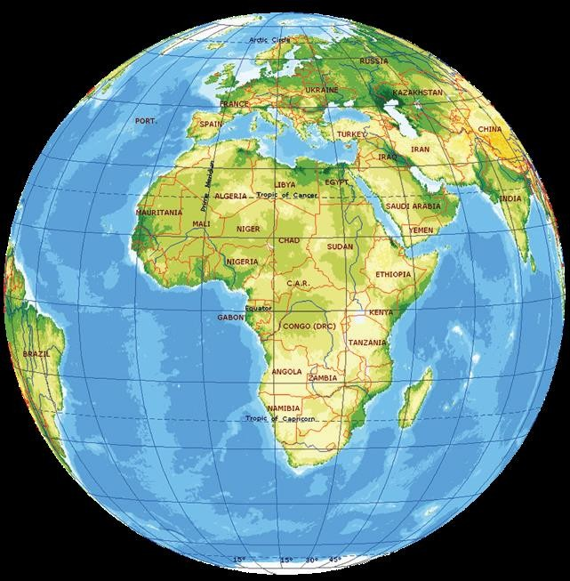

Slide 12
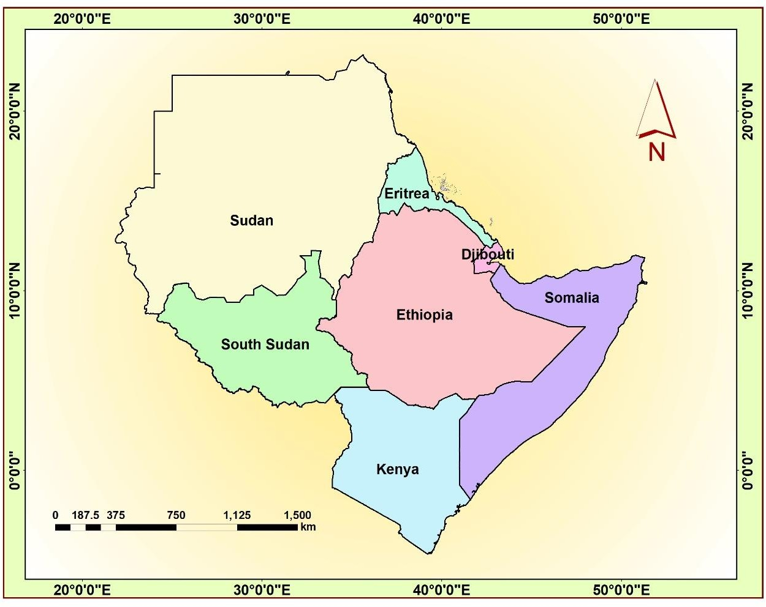
Figure 1.1:Ethiopia’s location in relation to its neighboring countries

Slide 13
    The Size of Ethiopia:
      Ethiopia with a total area of approximately 1,106,000 km2 is the 8th largest country in Africa and 25th in the World.
        It extends about 1,639 kilometers East-West, and 1,577 kilometers North- South.
        About 0.7% of the country is covered by water bodies.
        The size of Ethiopia is also affects both the natural and human environment of the country.

Slide 14
Advantages and disadvantages of large size
Advantages | Disadvantages
Possess diverse agro ecological zones | Demands greater capital to construct infrastructural facilities
Variety of natural resources | Requires large army to protect its territory
Own extensive arable land | Difficult for effective administration
Have larger population size | Difficult for socio-economic integration
Home for diverse cultures
Greater depth in defense external invasion

Slide 15
1.2.3. The shape of Ethiopia and its Implications:
The shape of a country has an implication on defense, administration and economic integration.
Countries of the World have different kinds of shape:
Compact shape countries: The distance from the geographic center of the state to any of the borders does not vary greatly.
  It is easier for defence, socioeconomic and cultural integration.
Fragmented shape countries: They are divided from their other parts by either water, land or other countries.

Slide 16
Elongated shape countries: They are geographically long and relatively narrow like Chile.
Perforated shape countries: A country that completely surrounds another country like the Republic of South Africa.
Protrude shape countries: Countries that have one portion that is much more elongated than the rest of the country like Myanmar and Eritrea.
Note: There are various ways of measuring shape of countries.
  These measures are known as the indices of compactness.
These indices measure the deviation of the shape of a country from a circular shape.

Slide 17
Focus: there is no country with absolutely circular shape, those approximating a circular shape are said to be more compact.
The four most commonly used measures of compactness:
  The ratio of area of country to its boundary length: Area-Boundary ratio.
    The higher the A/B ratio, the greater the degree of compactness.
  Boundary-Circumference ratio
It measures how far the boundary of a country approximates the circumference of a circle of its own size.
  the nearer the ratio to 1 the more compact the country is.

Slide 18
3) Area-Circumference ratio:
It compares the area of the country with the circumference of a circle that passes touching the extreme points on the boundary of the country.
  The higher the A/C ratio, the greater the degree of compactness.
Area-Area (A/A’) ratio:
  The ratio of the actual area of a country to the smallest possible inscribing circle
    The nearer the ratio to 1, the more compact the country is.

Slide 19
Ethiopia's shape compared to its neighbors in the Horn
Country | Area(km²) | Boundary (km) | A/B ratio | B/C ratio | A/C ratio
Ethiopia | 1,106,000 | 5,260 | 210.27 | 1.41 | 296.61
Djibouti | 22,000 | 820 | 26.83 | 1.56 | 41.83
Eritrea | 117,400 | 2,420 | 48.51 | 1.99 | 96.83
Kenya | 582,644 | 3,600 | 161.85 | 1.33 | 215.28
Somalia | 637,657 | 5,100 | 125.03 | 1.80 | 225.22

Slide 20
1.3. Basic Skills of Map Reading
What is a Map?
A map is a two-dimensional scaled representation of part or whole of the Earth surface on a flat sheet of paper.
  Map reading encompasses a systematic identification of natural features and manmade features.
Note: Geographers use maps as primary tools for displaying and analyzing spatial distributions, patterns and relations.
Importance of maps:
  Provide the basis for making geographical details of regions represented i.e. the geographical facts of an area such as relief, drainage, settlement etc.

Slide 21
Maps are powerful tools for making spatial analysis of geographical facts of areas represented.
Maps are useful for giving location of geographical features by varied methods of grid reference, place naming etc.
Maps are used on various disciplines like land use planning, military science, aviation, tourism, marine science, population studies, epidemiology, geology, economics, history, archaeology, agriculture etc.
  Map makes storage of the geographical data of areas represented.

Slide 22
Maps are potentially used to asses’ reliable measurements of the geographical features like area, size, distance etc.
  Types of Maps:
    Based on their purpose and functions maps can be classified as:
Topographical maps:
  depict one or more natural and cultural features of an area.
    They could be small, medium or large scale depending on the size of the area represented.
Contents of topographical maps depend on purpose of a map, scale of a map, date of compilation, and nature of the land represented.

Slide 23
Special purpose/statistical maps:
  show distribution of different aspects such as temperature, settlement, vegetation etc.
Marginal Information on Maps (Elements of Maps):
  Marginal information is shown on a map to enable the reading and interpretation of the geographical information of an area represented
rainfall,
Title: It is the heading of the given map which tells what the map is all about.
Key (legend): It is the list of all convectional symbols and signs shown on the map with their interpretation.

Slide 24
c) Scale: It is the ratio between the distance on the map and the actual ground distance.
enable the map user to interpret the ground measurement like road distance, areal sizes, gradient etc.
North arrow: It is indicated with the north direction on a map; used to know the other important directions of the mapped area like east, west, south, and north.
Margin: Is the frame of the map. It is important for showing the end of the mapped area
Date of compilation: It is a date of map publication.

Slide 25
This enables map users to realize whether the map is updated or outdated.
Basic Principles of Map Reading:
  Map Readers must have ideas about the symbol and also the real World (landscapes).
  knowledge of directions is an important principle in reading maps
    Unless a reader knows the basic directions, he or she may not use a map effectively.
……………… //……………..!

Slide 26
CHAPTER TWO
2. THE GEOLOGY OF ETHIOPIA AND THE HORN
2.1. Introduction
Geology: is an Earth science that studies the evolution of the earth, the materials of which it is made of, and the processes acting upon them.
The earth’s continents were once punched up together in to a single huge
continent called Pangaea.
The large super continent was then split into Gondwanaland where Africa is a part and Laurasia; and later into smaller fragments over the last million years.

Slide 27
fragmented
☑Gondwanaland
into;
Africa
South America
Antarctica
Australia and
India.
☑Laurasia further into;
North America
Europe
Asia and
Green land.
fragmented

Slide 28
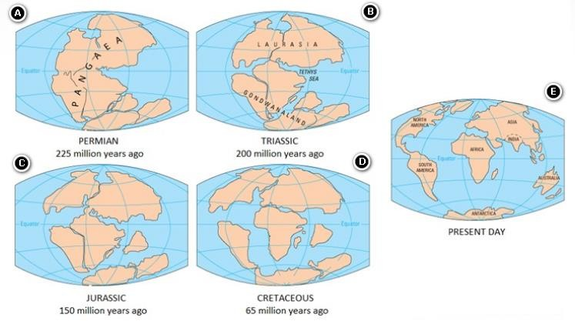

Slide 29

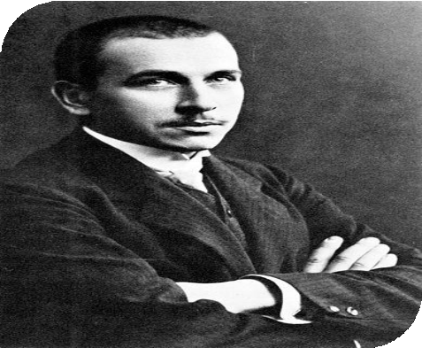
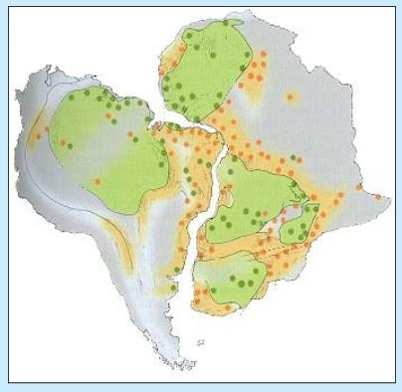
A German Climatologist Alfred Wegener proposed the hypothesis (continental drift theory) that the continents were once assembled together as a supercontinent.
Wegener’s principal observations were:
Fit of the continents: The opposing coastlines of continents often fit together.

Slide 30
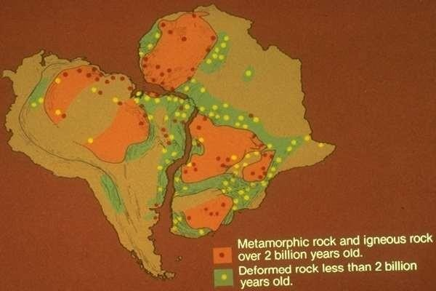
Match of mountain belts, rock types: If the continents are reassembled as Pangaea, mountains in West Africa, North America, Greenland, and Western Europe match up.
South America and Africa fit together not in outline, but also in rock types and geologic structure.
ROCK DISTRIBUTION

Slide 31

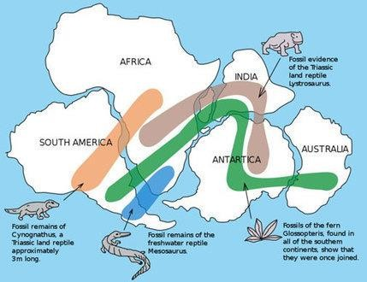
Distribution of fossils: The distribution of plants and animal fossils on separate continents forms definite linked patterns if the continents are reassembled.
Fossils and types of rocks on the eastern coast of S. America matched those on the west coast of Africa.

Slide 32
Paleoclimates: is the study of past/ancient climates before availability of instrumental records.
  rocks formed 200 million years ago in India, Australia, South America, and southern Africa all exhibited evidence of continental glaciations.
2.2. The Geologic Processes: Endogenic and Exogenic Forces
Geology studies of how Earth's materials, structures, processes and organisms have changed over time.
  These processes are divided into two major groups: internal and external
The internal processes (endogenic) include volcanic activity and all the tectonic processes folding, faulting, orogenesis (mountain building), and epeirogenesis (slow rising and sinking of the landmass).

Slide 33
These processes result in building of structural and volcanic features like plateaus, rift valleys, Block Mountains, volcanic mountains, etc.
The external (exogenic) processes are geomorphic processes.
  They include weathering, mass transfer, erosion and deposition.
    They act upon the volcanic and structural landforms by modifying, roughening and lowering them down.
Note: The landmass of Ethiopia, as elsewhere, is the result of the combined effect of endogenic and exogenic processes

Slide 34
2.3. The Geological Time Scale and Age Dating Techniques
The geological history is divided in to Eras
  Each Era is divided into periods
The Eras are given names that indicate the kind of life that existed in them.
  the Paleozoic Era (ancient life) is the age of invertebrates,
  the Mesozoic Era (the middle life) is the age of reptiles
  the Cenozoic Era (recent life) is the age of mammals.
Focus: Geological time is difficult to measure precisely.

Slide 35
The Earth is believed to have been formed approximately 4.6 billion years ago
the earliest forms of life were thought to have originated approximately 3.5 billion years ago.
  The span of time before life appeared was termed the Precambrian Era.
To describe the geology and history of life on Earth, scientists have developed the geological time scale.
The geological time scale measures time on a scale involving four main units:
1) An epoch is the smallest unit of time on the scale and encompasses a period of millions of years.

Slide 36
Chronologically, epochs are clumped together into larger units called periods.
Periods are combined to make subdivisions called Eras.
An eon is the largest period of geological time.
The division of time units in the geological time scale is usually based on the occurrence of significant geological events (e.g. mass extinctions).
  the geological time categories do not usually consist of a uniform length of time.

Slide 37
Table 2.1: The Geological time scale
Era | Period | Began (in Million Years) | End (my) | Major Events (million years ago
Cenozoic | Quaternary | 1.6 | Present | Major glaciers in North America and Europe (1.5)
 | Tertiary | 70 | 1.6 | Rocky Mountains (65), individual continents take shape.
Mesozoic | Cretaceous | 146 | 70 | Dinosaurs extinct (65), western interior seaway and marine reptiles (144 – 65)
 | Jurassic | 208 | 146 | Pangaea (one land mass) begins to break up (200)
 | Triassic | 225 | 208 | First mammals and dinosaurs
Paleozoic | Permian | 290 | 225 | Greatest extinction on Earth (245)
 | Pennsylvani an | 322 | 290 | First reptiles
 | Mississippia n | 362 | 322 | Coal-forming forests
 | Devonian | 408 | 362 | First land animals and first forests (408)
 | Silurian | 439 | 408 | Life invades land
 | Ordovician | 510 | 439 | First fish appeared
 | Cambria | 600 | 510 | Great diversity of marine invertebrates
Precambrian | Proterozoic | 2,500 | 600 | Marine fossil invertebrates (600)
 | Archean | 4,500 | 2,500 | Earliest fossils recorded (3,500), earliest rock formation (4,000)

Slide 38
Age Dating Techniques:
  There are two techniques of knowing the age of rocks: Relative and absolute age dating.
Relative Dating:
  Relative dating uses geological evidence to assign comparative ages of fossils
we can use two ways to know the relative age of a rock:
  one way is to look at any fossils the rock may contain.
    If any of the fossils are unique to one of the geologic time periods, then the rock was formed during that particular time period

Slide 39
The second way is to use the "What is on top of the older rocks?"
  Mostly younger rocks are on top of older rocks.
The above two methods only give the relative age of rocks -which one is younger and which is older.
b) Absolute Dating (Radiometric):
This technique was developed with discovery of radioactivity in 1896.
  Radioactive elements such as uranium (U) and thorium (Th) decay naturally to form different elements or isotopes of the same element.
Note: Every radioactive element has its own half-life.

Slide 40
Two of the major techniques include:
a) Carbon-14 Technique: Upon the organism’s death, carbon-14 begins to disintegrate at a known rate, and no further replacement of carbon from atmospheric carbon dioxide can take place.
Carbon-14 has half-life of 5730 years
Potassium-Argon Technique: The decay is widely used for dating rocks.
  Geologists are able to date entire rock samples in this way, because potassium-40 is abundant in micas, feldspars, and hornblendes.
2.4. Geological Processes and the Resulting Landforms of Ethiopia and the Horn

Slide 41
2.4.1. The Precambrian Era Geologic Processes (4.5 billion - 600 million years ago)
The Precambrian Era covers 5/6th of the Earth’s history.
Note: Due to its remoteness in time and the absence of well-preserved fossils, our knowledge of the events is limited.
The major geologic event of the Precambrian Era was Orogenesis.
  the land was subjected to intense folding.
    accompanied by intrusive igneous activity.
The result was the formation of huge mountain ranges.

Slide 42
In between the orogenic periods and after the last orogenesis, there were long periods of denudation, which finally reduced these mountains to near-level (peneplained) rock surfaces.
This “levelled” surface was later (in the Mesozoic and Cenozoic Eras) covered by younger rock formations.
    The Paleozoic Era Geologic Processes (600million - 225 million years ago)
      The Paleozoic Era lasted for about 375 million years.
        The major geological process of this Era was denudation.
          The gigantic mountains that were formed by the Precambrian orogeny were subjected to intense and prolonged denudation.

Slide 43
At the end, the once gigantic mountain ranges were reduced to a “peneplained” surface.
Undulating plain with some residual features (inselbergs) here and there was formed.
The sediments were transported southward and eastward to form continental (in Africa) and marine deposits, respectively.
2.4.3. The Mesozoic Era Geologic Processes (225-70 million years ago)
This Mesozoic Era lasted for about 155 million years.
  It was an Era of alternate slows sinking and rising (epeirogenesis) of the landmass.

Slide 44
This process affected the whole present-day Horn of Africa and Arabian landmass.
At the same time the land was tilted eastward and therefore lower in the
southeast and higher in the northwest.
The subsidence of the land began about 225 million years ago.
  As the land sank slowly the sea invaded it starting from Somalia and Ogaden and slowly spreading northwestward (during the late triassic period).
    This phenomenon continued up to Jurassic period.
As the depth of the sea increased, mud (shale), gypsum and later lime were deposited.

Slide 45
The latter is associated with the flourishing of marine life and decaying and precipitating of their remains
Mesozoic rocks are considered to have the greatest potential for oil and gas deposits.
  the sands and lime were compacted to form sandstone and limestone layers respectively.
o These are known as the Adigrat sand stone and Hintalo limestone layers.
In the Horn of Africa and Ethiopia, the slow rise of the land and consequently the regression of the sea began in the Upper Jurassic.
  With the retreat of the sea, another process of deposition occurred.

Slide 46
In the country sedimentation ended with the deposition of clay, silt, sand conglomerate
o The uppermost layer is known as the Upper sandstone.
By the end of the Mesozoic Era, three major sedimentary formations were laid and formed:
  These were the Adigrat or lower sandstone, Hintalo limestone and Upper Sandstone.
    The Mesozoic sedimentary rocks cover 25% of the land mass of the country.
  The Adigrat sandstone is older and thicker in the southeast and progressively decreases in age and thickness northwestward.

Slide 47
The Upper sandstone, is thicker and younger in the Southeast, while in the Northwest it is older and thinner.
  The transgressing sea and Mesozoic sediments nearly covered the whole of Ethiopia.
    The Cenozoic Era Geologic Processes (70million years ago - Present)
      The Cenozoic Era is the most recent of the geologic Eras.
The tectonic and volcanic activities that took place in this Era have an important effect in the making of the present-day landmass of Ethiopia and the Horn of Africa.

Slide 48
The land was subjected to three major geologic events:
Uplifting of the Arabo-Ethiopian landmass and outpouring of huge quantity of lava.
Formation of the Rift Valley and
Quaternary volcanism and deposition.
Uplifting of the Arabo-Ethiopian landmass and outpouring of lava flood:
  The uplifting of the whole of the Arabo-Ethiopian landmass is a continuation of the slow rise that began in the Upper Jurassic and Cretaceous periods.
    continued to the Paleocene and Oligocene epoch of the Tertiary period.

Slide 49
Where the uplifting was of greater magnitude, the land was pushed up to a maximum height of 2,000 meters above sea level.
o This occurred during the Eocene epoch.
The whole of the Arabo-Ethiopian landmass was pushed up in blocks as one mass.
  The greatest uplift was in central Ethiopia.
At that time the Rift Valley was not yet formed.
b) The Formation of the Rift Valley:
The formation of the Rift Valley is said to be related with the theory of plate tectonics.

Slide 50
the theory states, the Rift Valley may be lying on the Earth’s crust below which lateral movement of the crust in opposite directions producing tensional forces that caused parallel fractures or faults on the sides of the up-arched swell.
  As the tension widened the fractures, the central part of the landmass collapsed to form an extensive structural depression known as the Rift Valley
The major faulting movement probably began in the late Oligocene and Miocene Epochs of the Cenozoic Era.
  Rifting and faulting, however, continued all the time throughout the Pliocene and even the Pleistocene Epochs.
  The Red Sea and the Gulf of Aden were connected as a result of the rifting and faulting

Slide 51
the Afar depression (including the Gulf of Zula) was down-faulted allowing the Red Sea
the Danakil Depression and the Red Sea was uplifted to form the Afar Block Mountains.
The Spatial Extent of the Rift Valley:
The Ethiopian Rift Valley is part of the Great East African Rift system that extends from Palestine-Jordan in the north to Malawi-Mozambique in the south,
a distance of about 7,200 kilometers.
o Of these, 5,600 kilometers is in Africa, and 1,700 kilometers in Eritrea and Ethiopia.

Slide 52
On land, the widest part of the Rift Valley is the Afar Triangle (200-300 km).
The Red Sea, the Gulf of Aden, and the East African System meet and form the triangular depression of the Afar where the Kobar Sink lies about 125 meters below sea level.
The formation of the Gulf of Aden and the separation of the Arabian Peninsula from the Horn of Africa
The Rift Valley region of Ethiopian is the most unstable part of the country.
  There are numerous hot springs, fumorales, active volcanoes, geysers, and frequent earthquakes.
Note: The formation of the Rift Valley has the following structural
(physiographic) effects:

Slide 53
It divides the Ethiopian Plateau into two.
It separates the Arabian landmass from African landmass.
It causes the formation of the Dead Sea, Red Sea and the Gulf of Aden troughs.
It creates basins and fault depressions on which the Rift Valley lakes are formed.
c) Quaternary Volcanic Eruptions and Depositions
They are recent volcanic activities that took place after the formation of the Rift Valley (Pliocene-Pleistocene Epochs)
  This activity was generally limited to the floor of the Rift Valley and the region south of Lake Tana.

Slide 54
Aden volcanics and recent faulting are more extensively developed in the Afar region.
The basic volcanic features of the Aden series include the following:
  Numerous and freshly preserved volcanic cones, many of which have explosive craters. Some of these are active Dubi, Erta Ale, Afrera etc.
    Erta Ale is the most active volcano in Ethiopia.
  Volcanic hills and mountains, some of which are semi-dormant (Fantale, Boseti-Gouda near Adama, Aletu north of Lake Ziway, Chebbi north of Lake Hawassa etc.).

Slide 55
Extensive lava fields and lava sheets some of which are very recent.
Lava ridges
Thermal springs, fumaroles etc.
  Quaternary Deposition:
the Earth experienced a marked climatic change, where warmer and dry periods were alternating with cooler and wet periods.
the time of the last ‘’Ice Age’’ in the middle and high latitude areas and the time of the ‘‘Pluvial Rains’’ in Africa.

Slide 56
The heavy Pluvial Rains eroded the Ethiopian plateau and the eroded materials were deposited in the Rift Valley lakes.
  The excessive rain resulted in an excessive surface flow; rivers were many and large.
They carried a lot of water and sediments.
  Lake and marshy areas became numerous and deep.
Ziway-Langano-Shalla; Hawasa-Shallo; Chamo-Abaya; and Lake Abe and the nearby smaller lakes and marsh basins formed huge lakes.
After the ‘‘Pluvial Rains’’, the Earth’s climate became warmer and drier.

Slide 57
The quaternary deposits are mainly found in the Rift Valley (Afar and Lakes Region), Baro lowlands, southern Borena, and parts of northwestern low lands.
Generally, the Cenozoic rocks cover 50% of the land mass of the country.
2.5. Rock and Mineral Resources of Ethiopia
The occurrence of metallic minerals in Ethiopia is associated with the Precambrian rocks.
  The exploitation and search for mineral deposits in Ethiopia has been taking place for the past 2,000 years
2.5.1. Brief Facts and Current State of Main Minerals in Ethiopia
Ethiopia has abundant mineral resources of metals and precious metals, coal,
and industrial minerals.

Slide 58
The major minerals in Ethiopia include: gold, platinum, potash, tantalum,
Gypsum and Anhydrite, marble etc.
Gold:
  mined in Benishangul-Gumuz (Metekel), Adola., Lega-dembi, Adola etc.
Platinum:
  The Yubdo area in Wellega, is the only active Ethiopian Platinum mine.
Tantalum
  Significant deposit of tantalum and niobium is found in southern Ethiopia
……………… //……………..!

Slide 59
CHAPTER THREE
THE TOPOGRAPHY OF ETHIOPIA AND THE HORN
  Introduction
The topography of Ethiopia is largely determined by the geologic activities of the Cenozoic Era.
General Characteristics of the Ethiopian Physiography
  The Ethiopian landform is characterized by great diversity.
    There are flat-topped plateaus, high and rugged mountains, deep river gorges and vast plains.
Altitude ranges from 125 meters b.s.l (Kobar Sink) to the highest mountain in Ethiopia, Mount Ras Dashen (4,620 m.a.s.l), fourth highest mountain in Africa.

Slide 60
Ethiopia has the largest proportion of elevated landmass in the African continent (Roof of East Africa).
  More than 50% of the Ethiopian landmass is above 1,000 meters of elevation; and above 1,500 meters makes 44% of the country.
  Most of the Ethiopian Highlands are part of central and northern Ethiopia, and its northernmost portion extends into Eritrea.
The Ethiopian Highlands are rugged mass of mountains, situated in the Horn of Africa.
  Most of the country consists of high plateau and mountain ranges that are sources of many rivers and streams
    the country to be described as the “Water Tower of East Africa”.

Slide 61
The diversity in topography is accompanied by differences in other natural features such as soil, climate, vegetation and wild life.
Characteristics of Ethiopian highlands:
  Moderate and high amount of rainfall (>600 mm/year),
Lower mean annual temperature (<20⁰C),
The climate is favourable for biotic life,
Rain-fed agriculture is possible,
Free from tropical diseases,
Attractive for human habitation and densely settled etc.

Slide 62
Note: the highlands have been significant throughout Ethiopian history in the economic, cultural and political life of the people.
highlands make up nearly 56% of the area of the Ethiopia.
  subdivided into lower highland (1,000 - 2,000 m.a.s.l), which make up 35% and higher highland (>2,000 m.a.s.l) constituting nearly 22%.
Characteristics of Ethiopian lowlands (40%):
  Fewer amounts of rainfall and higher temperature,
  High prevalence of tropical diseases,
  Lower population densities,
  Nomadic and semi-nomadic economic life,

Slide 63
Vast plain lands favourable for irrigation agriculture along the lower river basins etc.
  The Physiographic Divisions of Ethiopia
    The three major physiographic units in Ethiopia:
The Western Highlands and Lowlands
  This physiographic unit includes all the area west of the Rift Valley.
    It extends from north to south encompassing nearly the whole western half of Ethiopia.
    It makes up about 44% of the area of the country.

Slide 64
This region is further subdivided into four groups of highlands (76.3%) and four groups of lowlands (23.7%)
  The Western Highlands
    The Tigray Plateau:
      It extends from the Tekeze gorge in the south to central Eritrean highlands
        It is separated from the Eritrean plateau by the Mereb River.
        It constitutes about 13% of the area of the region.
Most of the land being in between 1,000 and 2,000 m.a.s.l.
There are high mountains in this plateau with elevations of over 3000 meters, namely Mount Tsibet (3988 m.a.s.l), Mount Ambalage (3291 m.a.s.l), and Mount Assimba (3248 m.a.s.l).

Slide 65
The famous monastery at Debre-Damo, a tableland that can only be climbed by a rope pulley is also located in this plateau region.
  North Central Massifs:
    This Physiographic division is the largest in the western highlands.
      its northern and southern limit follows the Abay and Tekeze gorges.
58% of the region is at an altitude of more than 2,000 meters
  the second highest physiographic division next to the shewan plateau
  The region consists of the Gonder, Wello and Gojjam Massifs.
Out of the 26 mountain peaks with altitude of more than 4,000m.a.s.l in Ethiopia, 19 mountain peaks are found in this physiographic region.

Slide 66
Mount Ras Dashen (4,620 m.a.s.l), Mount Weynobar/Ancua (4462 m.a.s.l), Mount KidisYared (4453 m.a.s.l), and Mount Bwahit (4437 m.a.s.l) in the Simen Mountain System.
Mount Guna (4,231m.a.s.l) in the Debre Tabour Mountain System, Abune Yoseph (4,260 m.a.s.l) in the Lasta highlands of Wello and Mount Birhan (4,154 m.a.s.l) in the Choke Mountain System in Gojjam are also part of Simen Mountain System.
c) The Shewa Plateau/central highlands
is bounded by the Rift Valley in the east and southeast, by the Abay gorge in its northern and western limit, and the Omo gorge in the south and west.
  This plateau occupies a central geographical position in Ethiopia.
It is the smallest of the Western highlands (11%)

Slide 67
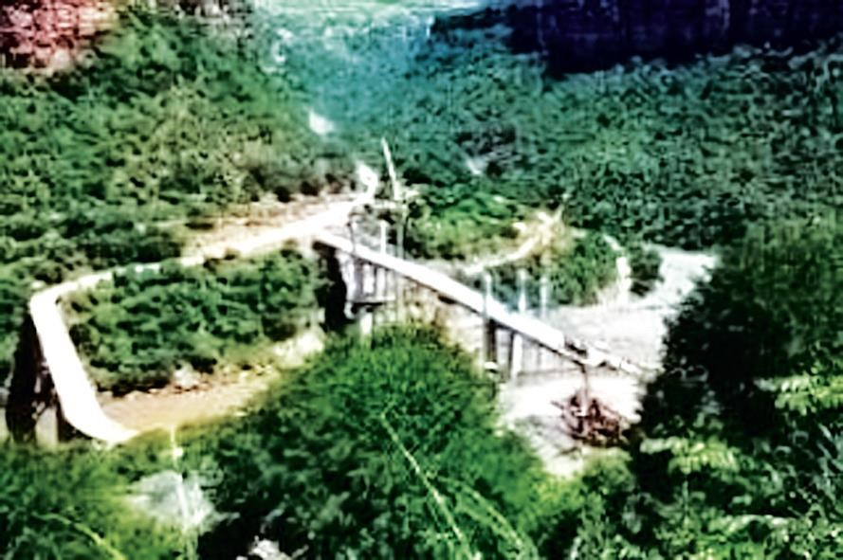
Fig.: The Abbay Gorge

Slide 68
Nearly 3/4 of its area is at an altitude of more than 2,000 meters
  therefore, the largest proportion of elevated ground
is drained outward in all directions by the tributaries of Abay, Omo, and Awash.
  The tributaries of Abay: Guder, Muger, Jema etc. have cut deep gorges and steep sided river valleys.
The highest mountain in the Shewan plateau is Mount Abuye-Meda (4,000 m.a.s.l) in Northern Shewa, Mount Guraghe in the south is 3,721 meters high.
d) The Southwestern Highlands
This Physiographic subdivision consists of the highlands of Wellega, Illuababora, Jimma, Kaffa, Gamo and Gofa.
  It is the second largest in the Western highlands (22.7%)

Slide 69
It extends from the Abay gorge in the north to the Kenya border and Chew Bahir in the south.
  About 70% of its area lies within 1,000-2,000 meters altitude.
The southwestern plateau is the wettest in Ethiopia.
  It is drained by Dabus, Deddessa (tributaries of Abay), Baro, Akobo and the Ghibe/Omo rivers.
the most dissected and rugged terrain that accommodates the most numerous and diverse ethnic linguistic groups in Ethiopia.
  Mount Guge is the highest peak (4,200 m) in this physiographic subdivision.
The Western Lowlands:
  extend from Western Tigray in the north to southern Gamo-Gofa in the South.

Slide 70
The general elevation ranges between 500 and 1000 meters above sea level.
is further subdivided into four by the protruding ridges.
These are the Tekeze lowland, Abay-Dinder lowland, Baro lowland, and Ghibe lowland from north to south.
  With the exception of the Baro lowland, the region is generally characterized by arid or semi-arid conditions.
    Pastoral or semi-pastoral economic activities dominate the area.
  As one moves northwards, the degree of aridity increases, making rain-fed agriculture more difficult.

Slide 71
The Southeastern Highlands and Lowlands
  This physiographic region is the second largest in terms of area.
    accounts for 37% of the area of Ethiopia.
    The highlands make up 46% of the physiographic division while the rest is lowland.
further subdivided into two units of highlands and two units of extensive lowlands:
  The Southeastern Highlands
    The Arsi-Bale-Sidama Highlands
      These highlands are found to the east of the Lakes Region.

Slide 72
They make up 28.5% of the area of the region and 62% of the south - Eastern Highlands.
Mount Kaka (4,180 m.a.s.l), Mount Bada (4,139 m.a.s.l) and Mount Chilalo (4,036 m.a.s.l).
The Bale highlands are separated from the Arsi highlands by the head and main stream of Wabishebelle.
  The highest mountain peaks in this region are Tulu-Demtu (4,377 m.a.s.l) and Mount Batu (4,307 m.a.s.l).
    The Arsi-Bale Highlands are important grains producing areas with still high potential.

Slide 73
The Sidama Highlands are separated from the Bale Highlands by the Ghenale river valley.
  They occupy the southwestern corner of this region.
  The prominent feature here is the Jemjem plateau, an important coffee growing area.
  Rivers Wabishebelle and Ghenale along with their tributaries have dissected this physiographic region.
  Weyb River, tributary of Ghenale, has cut an underground passage (Sof Omar cave) through the Mesozoic Limestone rocks.
  The cave is found near Bale Mountains.

Slide 74
The Hararghe Plateau:
  is a north-easterly extension of the south-eastern highlands.
extends from the Chercher highlands in the south-west to Jigjiga in the east.
makes up 38% of the South Eastern highlands and 17.4% of the whole physiographic region.
It has the smallest proportion of upper highland (>2,000 meters).
Much of the Trappean lava is removed and the Mesozoic rocks are extensively exposed.
The highest mountain here is Mount Gara-Muleta (3,381 m.a.s.l).

Slide 75
The Southeastern Lowlands:
  are located in the southeastern part of the country and they are the most extensive lowlands in Ethiopia.
    They make up 54% of the area of the physiographic region and around one- fifth of the country.
    is divided into Wabishebelle plain (60%) and the Ghenale Plain (40%).
o include the plains of Ogaden, Elkere, and Borena.
    Because of the harsh climatic conditions, these lowlands are little used and support very small population.
    sparsely inhabited by pastoral and semi-pastoral communities.

Slide 76
The economic potential for this region includes animal husbandry, irrigation, agriculture and perhaps exploitation of petroleum and natural gas.
3.2.3. The Rift Valley:
is a tectonically formed structural depression.
  is bounded by two major and more or less parallel escarpments.
the Rift Valley has separated the Ethiopian Highlands and Lowlands in to two.
  extends from the Afar triangle in the north to Chew Bahir for about 1,700 km².
  covers 18% of the area of Ethiopia.
is elongated and funnel shaped, with a NE-SW orientation
It opens out in the Afar Triangle, where it is the widest, and narrows down to the south.

Slide 77
The floor of the Rift Valley is made up of interconnected troughs, grabens and depressions.
Altitude in the floor ranges from 125 meters b. s. l. at Dallol Depression, to as high as 2,000 meters a. s. l. in the Lakes region.
  subdivided into three physiographic sub-regions:
    the Afar Triangle, the Main Ethiopian Rift, and the Chew Bahir Rift.
The Afar Triangle:
  is the largest and widest part of the Rift Valley.
    makes up 54% of the Rift Valley area.
    low altitude (300-700 m).

Slide 78
most hostile environments on Earth (maximum temperatures can exceed 50°C during the summer wet season
characterized by faulted depressions (grabens), volcanic hills, active volcanoes, volcanic ridges, lava fields and low lava platforms.
Lakes (Abe, Asale, and Afrera) occupy some of these basins.
A prominent feature in this region is the Denakil Depression (Kobar Sink).
  A larger part of this is covered by thick and extensive salt plain.
  Lake Asale and Lake Afrera occupy the lowest parts of this sunken depression.
  The Afar Triangle is generally hot and dry.
The economic importance of this region includes salt extraction, irrigation along the Awash River and electric potential from geothermal energy.

Slide 79
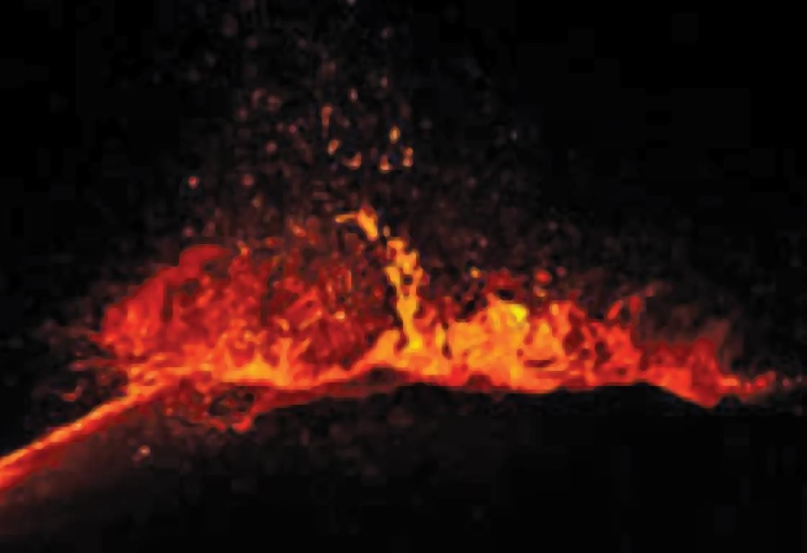
Fig: Ertalle

Slide 80
The Main Ethiopian Rift/Central Rift:
  refers to the narrow belt of the R. V. that extends from Awash River in the north to Lake Chamo in the south.
is bounded by the western and eastern escarpments.
is the narrowest and the highest.
has an average width of 50-80 kilometers and general elevation of 1,000-2,000 meters above sea level.
  The floor in many places is dotted by cinder cones and volcanic mountains.
  The big ones include Mount Fentale, Boseti-guda (near Adama), Aletu (north of Lake Ziway) and Chebi (north of Lake Hawasa).
  the lakes region of the Main Ethiopian Rift is generally milder and watery.

Slide 81
Here rain-fed agriculture is practiced.
Other resource bases include the recreational value of the lakes, the agricultural importance of some streams and lakes, and the geothermal energy potential.
The Chew Bahir Rift:
  is the smallest and the southern-most part of the Rift Valley.
    Gneissic highlands of Konso and the surrounding highlands separate it from the Main Ethiopian Rift to the north.
Characterized by broad and shallow depression, which is a marshy area covered by tall grass,

Slide 82
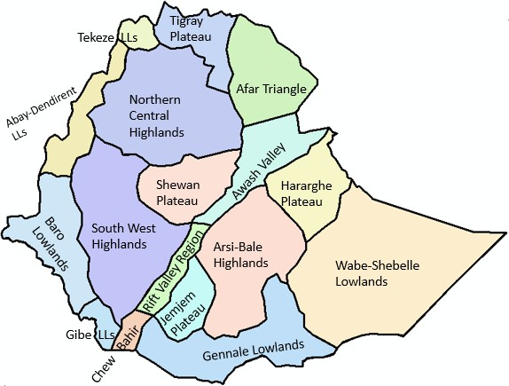

Slide 83
The Impacts of Relief on Biophysical and Socioeconomic Conditions
The highly dissected character of the landscape over much of the country's territory along with the limited extent to which flat surfaces are present influence the various socioeconomic aspects of Ethiopia as presented hereunder.
  Agricultural practices
Relief influences farm size and shape in that in an area of rugged terrain the farmlands are small in size and fragmented and tend to be irregular in shape.

Slide 84
 Choice of farming techniques and farm implements are highly influenced by relief as in rugged terrain mechanized farming techniques are difficult to practice.
Relief influences crop production as some corps are well adapted to higher altitudes (barley, wheat) and others to low altitude (sorghum, maize).
The practice of animal husbandry is also influenced by relief as most equines and sheep are reared in the higher altitudes and camels and goat are well adapted to lower altitudes
b) Settlement pattern:
Highlands of Ethiopia that experience a temperate type of climatic condition that are mainly free from most of the tropical diseases are densely settled.
 Rugged and difficult terrain hinders the development of settlement and its expansion.

Slide 85
c)Transportation and communication:
 The highlands of Ethiopia are characterized by sedentary life and permanent settlements while lowlands that are inhabited by pastoralists have temporary settlements.
The highly dissected nature of the landscape is a barrier to the development of internal surface transportation that resulted in the long-term isolation of many communities
  The difficult terrain makes infrastructure development and maintenance costly.
  The rugged topography rendered rivers less navigable due to the waterfalls, deep gorges and steep cliffs.
d) Hydroelectric power potential
The great difference in altitude coupled with high rainfall created suitable conditions for a very high potential for the production of hydroelectric power in Ethiopia.

Slide 86
e) Socio-cultural feeling
The rugged terrain as a result of excessive surface dissection resulted in the long- term isolation of communities that led to the occurrence of cultural diversity.
 People who live in the highlands have been identifying themselves as degegnas (mountaineers) and those who live in the lowlands as kollegnas (lowlanders).
f) Impacts on climate
The climate of Ethiopia is a result of the tropical position of the country and the great altitudinal variation of the general topography.
 Highlands with higher amount of rainfall and lower rate of evapo-transpiration tend to be moisture surplus compared to the moisture deficit lowlands.
g) Impacts on soil
Steep mountain slopes provide low angle of rest, unstable surface materials and subject to degradation processes and relatively form shallow and little developed soils.

Slide 87
h) Impacts on natural vegetation
Relief through its effect on climate and hydrology affect the type of natural vegetation grown in an area.

Slide 88
CHAPTER FOUR
Drainage Systems and Water Resource of Ethiopia and the Horn
Introduction:
About 71% of the earth’s total surface is covered by water bodies majorly occupied by seas and oceans.
Of the earth’s total water surface, nearly 97.5% is alkaline accumulated in seas and oceans.
The remaining 2.5% is fresh water, of which nearly 68.7% is deposited in glaciers, 30.1% in ground water, 0.8% in permafrost and 0.4% in surface waters.

Slide 89
Water in lakes, rivers, atmosphere, soils and wetlands are considered as surface waters.
Surface and ground waters are by far the most abundant and easily available fresh waters.
  Around 0.7 % of the total land mass of Ethiopia is covered by water bodies.
Ethiopia is called the water tower of “Eastern Africa”.
Major Drainage System of Ethiopia:
  How do you conceptualize drainage system?
The flow of water through well-defined channel is known as drainage.

Slide 90
A drainage system is made up of a principal river and its tributaries
A river system begins at a place called the source or headwater and ends at a point called mouth.
Therefore, a drainage system is branched network of stream channels together with the adjacent land slopes they drain.
  Drainage pattern of an area is the outcome of the:
    geological processes, nature & structure of rocks, topography, slope etc.
A drainage basin:
  is the topographic region from which a river and its tributaries collect both the surface runoff and subsurface flow.

Slide 91
Note: the general patterns of major river basins in Ethiopia are determined by topographical structures.
Major Drainage Systems in Ethiopia:
Why do rivers rise from higher slope and flow towards the lower?
Ethiopia possesses three major drainage systems namely:
  are the largest of all drainage systems draining 40% of the total area of the country and carry 60 percent of the annual water flow.

Slide 92
coextends with the westward sloping part of the western highlands and western lowlands.
  has four major river basins namely the Tekeze, Abay, Baro-Akobo, Ghibe (Omo).
the Ghibe (Omo) flows southward.
Abay, Tekeze and Baro flow westward ultimately joining the Nile & ends at Mediterranean Sea.
Abay River Basin:
  The largest river both in volumetric discharge and coverage in the western drainage systems is the Abay.

Slide 93
covers an area of 199,812 km², covering parts of Amhara, Oromia and Benishangul-Gumuz regional states.
it carries 65 percent of the annual water flow of the region
rises from Lake Tana (some sources indicate its origin from Sekela, Choke mountain) flows about 1,450 kilometres and joins the White Nile in Khartoum, Sudan to form the Nile Rever.
  The major tributaries of Abay are: Guder, Jema, Dedesa rivers etc.
Tekeze and its tributaries: carrying 12 percent of the annual water flow of the region drains 82,350 Km² of land surface

Slide 94
has two main tributaries (Angereb and Goang) which rises in the central highlands of Ethiopia.
is termed Atbara in Sudan, which is a tributary of the Nile.
Baro-Akobo and Ghibe/Omo rivers: drain the wettest highlands in the south and southwestern Ethiopia.
  carry 17 percent and 6 percent of the annual water flow respectively
    In the lower course, the Baro River flows across an extensive marshy land
      has an area of 75,912 km², covering parts of the Benishangul- Gumuz, Gambella, Oromia, and SNNPR.

Slide 95
Baro together with Akobo forms the Sobat River in South Sudan.
The Ghibe/ Omo River finally empties in to the Chew-Bahir at the mouth of Lake Turkana.
b) The Southeastern Drainage Systems:
The basin which is mainly drained by Wabishebelle and Ghenale,
slopes south-eastwards across large water deficient plains.
  Major highlands of this basin include plateaus of Arsi, Bale, Sidama and Harerghe.
    Wabshebelle and Ghenale cross the border into Somalia, carrying
25% of the annual water flow of Ethiopia.

Slide 96
Ghenale river basin has an area of 171,042 km², covering parts of Oromia, SNNPR, and Somali regions.
  Ghenale, which has fewer tributaries but carries more water than
Wabishebelle, reaches the Indian Ocean.
o In Somalia it is named the Juba River
Wabishebelle with a total catchment area of 202,697 km², is the largest river in terms catchment area.
o It is the longest river in Ethiopia
It drains parts of Oromia, Harari and the Somali regions.
fails to reach the Indian Ocean where at the end its water
disappears in the sands, just near the Juba River.

Slide 97
Ethiopian Rivers:
River | Catchment Area(km²) | Annual Volume BMC | Terminus/Mouth | Major tributaries
Abay | 199,812 | 54.5 | Mediterranean | Dabus, Dedessa, Fincha, Guder, Muger, Jema, Beshilo
Wabishebelle | 202,697 | 3.4 | Coast of Indian Ocean | Ramis Erer, Daketa Fafan
Genale Dawa | 171,042 | 6 | Indian-Ocean | Dawa, Weyb, Welmel, Mena
Awash | 114,123 | 4.9 | Inland (within Ethiopia) | Akaki, Kesem, Borkena, Mile
Tekeze | 87,733 | 8.2 | Mediterranean | Goang, Angereb
Gibe (Omo) | 79,000 | 16.6 | Lake Turkana | Gojeb
Baro Akobo | 75,912 | 23.23 | Mediterranean | Akobo
Source: Compiled from different basin development master plans

Slide 98
General Characteristics of Ethiopian Rivers:
  Almost all major rivers originate from the highlands elevating (>1500 m. a. s. l.)
  Majority of Ethiopian rivers are trans-boundary,
  extreme seasonal fluctuation (wet season, runoff is higher & rivers are full bursting their banks, destroying small bridges, damage roads and flooding low lands, during the dry seasons they became mere trickles of water or even dry up,
  have rapids and waterfalls along their course,

Slide 99
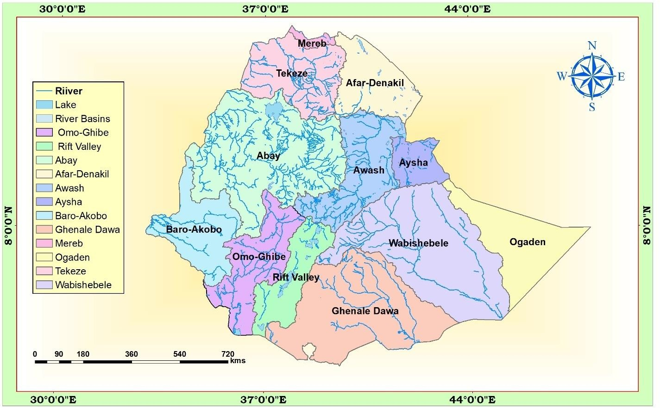
Drainage Basins of Ethiopia

Slide 100
The Rift Valley Drainage System:
  is an area of small amount of rainfall, high evaporation and small catchment area.
The only major river basin is that of the Awash.
has a catchment area of 114,123 km² and has an average annual discharge of 4.9 billion cubic meters.
originates from Shewan plateau in central highlands, & flows 1250 kms.
covers parts of the Amhara, Oromia, Afar, Somali, Dire Dawa, and Addis Ababa City

Slide 101
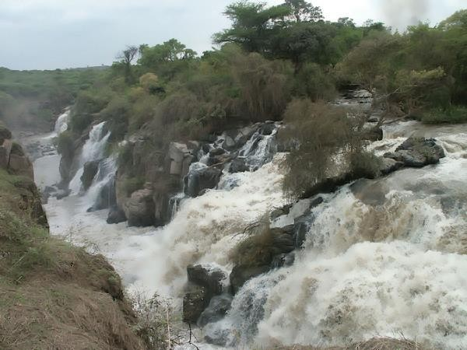
Fig.: The Awash River

Slide 102
Note: Awash is the most utilized river in the country.
Awash flows in a northeast direction & ends in a maze of small lakes and marshy area; the largest of which is Lake Abe on the Ethio-Djibouti border.
In the Rift Valley drainage systems, there is no one general flow direction (Following the Rift Valley orientation)
  The Afar drainage sub-basin has practically no stream flow.
    It is an area of little rain, very high temperature and very high evaporation.

Slide 103
Lake Afrera and Asale are the only main surface waters in the basin w/c formed by tectonic activities.
The Southern part of the Rift Valley is described as lakes region.
small streams that drain to the lakes (Meki and Katar Rivers flow into Ziway, Bilate into Abaya & Segen into Chew Bahir.)
Lakes Ziway and Langano drain into Lake Abijiata through the small streams of Bulbula and Horocolo respectively.

Slide 104
Ethiopian Lakes:
  Almost all Ethiopian lakes are result of tectonic process that took place during Quaternary period of Cenozoic era
Except few Ethiopian lakes, majority of lakes are located within the Rift Valley System.
Lake Tana, the largest lake in Ethiopia
  formed by slower sinking between Gojjam and Gonder massifs.
Crater lakes: Bishoftu, Wonchi (near Ambo), Hayk (near Dessie), on top of Mount Zikwala, Ashenge (Tigray) is formed on a tectonic basin.

Slide 105
man-made lakes: Koka, Fincha and Melka Wakena etc. dammed following hydroelectric power generation projects.
Note: Cluster of lakes are lined up within main Ethiopian rift
  Lake Abaya is the largest of all the lakes in the system.
Shala and Ziway are the shallowest and the deepest lakes in the central Ethiopian Rift respectively

Slide 106
Area and depth of some of Ethiopian Lakes
Lake | Area (km²) | Max. Depth(m) | Lake | Area (km²) | Max. Depth(m)
Tana | 3600 | 9 | Abijata | 205 | 14
Abaya | 1162 | 13.1 | Awassa | 129 | 10
Chamo | 551 | 13 | Ashenge | 20 | 25
Ziway | 442 | 8.95 | Hayk | 5 | 23
Shala | 409 | 266* | Beseka | 48.5 | 11
Koka | 205 | 9

Slide 107
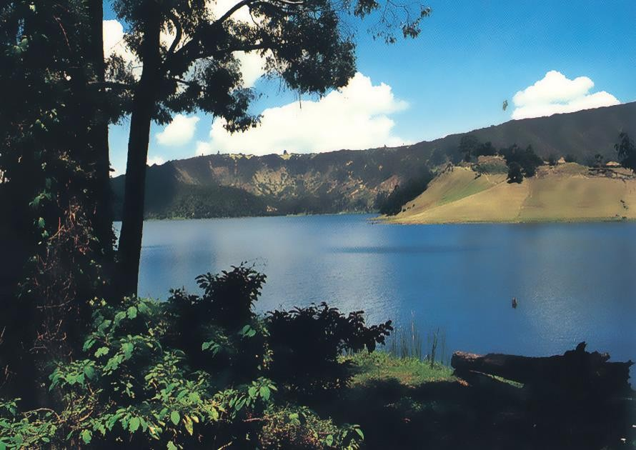
Lake Wonchi

Slide 108
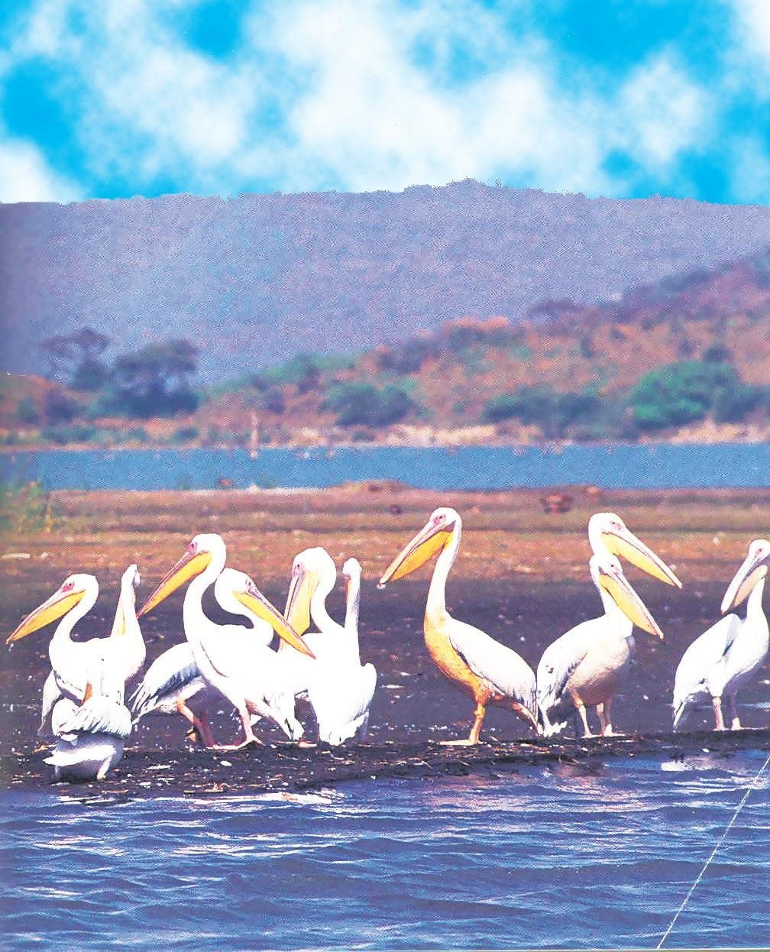
Fig.: Lake Shalla

Slide 109
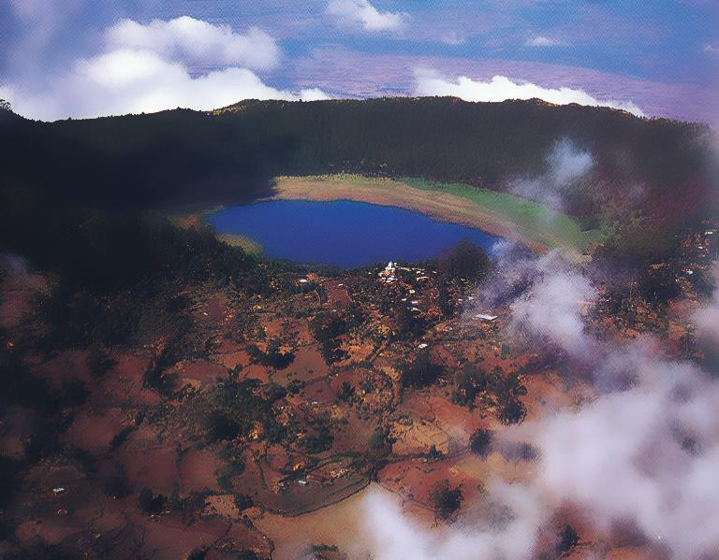
Fig.: Lake Zequala

Slide 110
Water Resources Potentials and Development in Ethiopia
  As compared to surface water resources, Ethiopia has lower ground water potential.
    Climatic and geophysical conditions determine the availability of groundwater resource
Generally, water resource potential of Ethiopia is underutilized due to so many factors like technology, location of rivers etc.
Hydro-electric Potential
  Ethiopian rivers have a very high potential for generating electricity /exploitable capacity about is 45000 MW

Slide 111
The first H.E.P.G. plant was installed on Akaki River (Aba Samuel) in 1932.
Currently Ethiopia is administering 14 hydroelectric power plants constructed on lake Aba Samuel, Koka, Tis Abay, Awash, Melka Wakena, Fincha, Gibe/Omo, Tana Beles and Tekeze etc.
The major problem related to the use of Ethiopian rivers for the hydroelectric power is:
  the seasonal flow fluctuations and impact of climate change and variability, sedimentation in the reservoirs etc.

Slide 112
Irrigation and Transportation
  The rugged terrain limits the uses of Ethiopian rivers both for irrigation and transportation
    In the highlands, steep slopes, rapids, waterfalls, narrow and deep valleys and gorges are important obstacles.
The Baro-Akobo and Genale Dawa river systems have large irrigation potential compared to other basins.
  >60% of the area under irrigation so far is located in Rift Valley Drainage System

Slide 113
Majority of Ethiopian rivers are not suitable for transportation. except Baro river
  Lake Tana and Abaya are relatively the most navigable
Fishing and Recreation:
  The majority of Ethiopian lakes are rich in fish
Currently Lake Tana and Chamo are potentially the major fishing grounds
> 60% of fish supplies are coming from Ethiopian main Rift Valley lakes.

Slide 114
Some of the lakes are threatened by sedimentation, invasive species (water hyacinth), over exploitation and expansion of investments around lakes.
CHAPTER FIVE
WEATHER & CLIMATE OF ETHIOPIA AND THE HORN
  What is the difference between weather & climate?
Weather: is the current state of the atmosphere including temperature, atmospheric pressure, humidity, wind speed and direction, cloudiness and precipitation.
  Hotness or coldness, rainy or cloudiness, sunniness, windiness or calmness, of air you are feeling on the daily base

Slide 115
Climate: refers the state of the atmosphere over long time periods, decades and more.
  is the composite of daily weather conditions recorded for long periods of time.
The climate of Ethiopia is controlled by the seasonal migration of
the ITCZ, complex topography of the country etc.
  ITCZ: is simply the convergence of Northeast trade & Equatorial westerlies winds
In Ethiopia, the temporal and spatial variations in elements of weather and climate because of its closeness to equator and Indian Ocean.

Slide 116
Elements and Controls of Weather and Climate:
Elements | Controls
1) Temperature | 1) Latitude and angle of the sun
2) Precipitation and humidity | 2) Land and water distribution
3) Winds and air pressure | 3) Winds and air pressure
 | 4) Altitude and mountain barriers
 | 5) Ocean currents

Slide 117
Controls of Weather and Climate:
1) Latitude:
is the distance of a location from the equator (angular location of a place to the direct rays of the sun)
  The sun shines directly on equator for more hours during the year than anywhere else.
towards the poles, less solar insolation is received during the year & the temperature become colder.
  Latitudinal location of Ethiopia and the Horn resulted in:

Slide 118
high average temperatures
high daily and small annual ranges of temperature
no significant variation in length of day and night between
summer and winter etc.
Inclination of the Earth's Axis:
  This inclination determines the location of the Tropics of Cancer, Capricorn and the Arctic and Antarctic Circles
As the earth revolves around the sun, inclination produces a change
in the directness of the sun's rays, which in turn causes the differences in length of day and seasons.

Slide 119
Rotation
occurs when something is spinning around an axis. Rotation of the earth is the spinning of earth on its axis it results
-Day and night
-Apparent movement of the sun
Revolution
The Earth is revolves around the sun (orbit of the sun) One full revolution takes 3651/4 days (1year) and it result
-Seasons
-Variation in the length of the day
As a result of inclination of the earth, rotation and revolution
-Solstice and
-Equinoxes are resulted

Slide 120
Equinoxes and Solstices:
An equinox is the instant of time when the sun strikes the plane of the Earth's equator
  the length of day and night are equal
Equinox appears twice a year:
-March 21st (Vernal/spring equinox)
-September 22nd (Autumn / fall equinox)
a) The Vernal (spring) equinox: is the day when the point of verticality of sun’s rays crosses the equator northwards.
the length of day and night are equal
Vernal (spring) equinox marks the beginning of Spring season
March 21 marks the offset of the vernal equinox.

Slide 121
The Autumn equinox: appears to happen when the sun crosses equator giving approximately equal length between day and night.
  sun moves south across the celestial equator on 23rd of September
  It marks the beginning of Autumn season
Solstice is when the overhead sun appears to cross northern or southern points to the equator resulting in unequal length of days and nights in the hemispheres/the sun is at its greatest distance from the equator/.
  The summer Solstice: on June 21st, the northern hemisphere has maximum tilt towards the sun experiencing longest daylight of the year.

Slide 122
It is the astronomical first day of summer in the Northern Hemisphere
b) The winter solstice: December 22nd, is the day when the maximum southward inclination is attained in S. hemisphere. it occurs when the sun overhead on 23 ½° S i.e. Tropic of Capricorn.
In this event, the sun inclination to south hemisphere caused longest night and shortest daylight for N. hemisphere.
3) Altitude:
Under normal conditions, there is a general decrease in temperature with increasing elevation. The average rate at which temperature changes per unit of altitudinal change is known as lapse rate.

Slide 123
This rate is limited to the lower layer of the atmosphere (Troposphere). The normal lapse rate is 6.5°c / km rise in altitude i.e. as altitude of places changed by 1 km, temperature change by 6.5°c.
Types of lapse rate:
  Dry adiabatic laps rate:
An adiabatic lapse rate is the rate at which the temperature of an air
parcel changes in response to the expansion or compression process associated with a change in altitude.
Vertical displacements of air are the major cause of adiabatic
temperature changes. When air rises, it expands because there is less weight of air upon it.

Slide 124
As long as the air in the parcel is unsaturated (humidity content of ˂ 100%) or movement of air does not changed to condensation, the rate of adiabatic cooling or warming remains constant.
That constant rate is 10°c/1km change in altitude & this rate which applied only in less humidity air is known as dry adiabatic lapse rate.
b) Wet Adiabatic laps rate:
If saturated air containing water droplets were to sink, it would
compress and warm at the moist adiabatic rate because evaporation of the liquid droplets would start the rate of compressional warming.

Slide 125
Hence, the rate at which rising or sinking saturated air changes its temperature is less than the dry adiabatic rate.
This process is called wet adiabatic temperature change. The rate of cooling of wet air is approximately 5⁰c per 1 km climbing.
c) Environmental/Atmospheric lapse late:
This is the inverse relationship b/n temperature & altitude meaning that temperature is highest at low altitudes but decreases as altitude increases
  because of atmospheric heat is from terrestrial radiation rather than from direct solar radiation.

Slide 126
lower layer of atmosphere is warmer since it closer to surface radiation, high density of lower atmosphere, full of water vapor and dust at low layer which can absorb earth radiation.
The rate of change is 6.5⁰c /km. Totally, this rate is formed due to inversion of temperature with altitude.
Spatio-temporal Distribution of Temperature:
The spatial distribution of temperature in Ethiopia is primarily determined by altitude and latitude
Tropical temperature conditions have no full spatial coverage b/c:

Slide 127
The Ethiopian topography is dominated by highlands
are limited to the lowlands in the peripheries.
Mean annual temperature varies from over 30 ⁰Cin the tropical lowlands to less than 10⁰c at very high altitudes.
The Bale Mountains are among highlands where lowest mean annual temperatures are recorded.
The highest mean maximum temperature in the country is recorded in the Afar Depression.

Slide 128
The major controls determining temperature distributions are latitude and cloud cover.
In the tropics, the daily range of temperature is higher and the annual range is small, whereas the reverse is true in the temperate latitudes.
Ethiopia’s daily temperatures are more extreme than its annual averages.
In Ethiopia and elsewhere in the Horn, temperature shows seasonal variations.
months from March to June have highest temperatures. Conversely, low temperatures are recorded from November to February.

Slide 129
there is a slight temperature increase in summer
Southern part of Ethiopia receives highest temperature in autumn and spring whereas the northern part of the country, summer season is characterized by higher temperature.
Spatiotemporal Distribution of Rainfall:
  Rainfall system in Ethiopia is characterized by complexities b/c:
    Influenced by the position of ITCZ
  In short, it is characterized by spatial and temporal variabilities.
The convergence of Northeast Trade winds and the Equatorial Westerlies forms the ITCZ, which is a low-pressure zone

Slide 130
inter-annual oscillation of the surface position of the ITCZ causes a variation in the Wind flow patterns over Ethiopia and the Horn.
Following the position of the overhead sun, the ITCZ shifts north and south of the equator.
  As a result equatorial westerlies from the south and southwest invade most parts of Ethiopia bringing moist winds.
The ITCZ shifts towards Tropic of Capricorn in January a& during this period, the Northeast Trade Winds carrying non-moisture- laden dominates the region.
  Afar and parts of Eritrean coastal areas experience rainfall in this period.

Slide 131
Following the directness of the Sun in March and September around the equator, the ITCZ shifts towards equator.
  During this time, the central highlands, southeastern highlands and lowlands receives rainfall as the south easterlies bring moist winds.
Seasonal or Temporal Variabilities:
rainfall is highly variable both in amount and distribution across regions and seasons.
  Summer (June, July, August):
    Characterized by heavy rain fall in most parts of Ethiopia

Slide 132
From mid-June to mid-September, majority of Ethiopian regions, except lowlands in Afar and Southeast, receive rainfall as the sun overheads north of the equator.
Ethiopia and the Horn are under the influence of the Equatorial Westerlies (Guinea monsoon) i.e. high pressure cells from Atlantic Ocean and Easterlies (high pressure cell of Indian Ocean).
the Guinea monsoon and the South easterly winds are responsible for the rain in this season.
b)Autumn (September, October and November):

Slide 133
Since ITCZ shifts to equator and equatorial westerlies become
weak, south easterlies trade wind invades moderate rain for
southeastern lowlands of Ethiopia.
the south easterlies from Indian Ocean are the source of rain for the lowlands in southeastern part of Ethiopia.
Winter (December, January and February):
  In winter, the overhead sun is far south of equator
Northeasterly winds originating from the landmass of Asia dominantly prevail Ethiopian landmass.

Slide 134
The northeasterly winds crossing the Red Sea carry very little moisture and supplies rain only to the Afar lowlands and the Red Sea coastal areas.
d) Spring (March, April and May):
the southeasterlies from the Indian Ocean provide rain to the highlands of Somalia, and to the central and southeastern lowlands and highlands of Ethiopia.

Slide 135
Rainfall Regions of Ethiopia:
Based on rainfall distribution, both in space and time, four rainfall regions are there:
  Summer rainfall region:
comprises almost all parts of the country, except the southeastern and northeastern lowlands
The region is divided in to dry and wet />1000 mm/ summer rainfall
2) All year-round rainfall region:
has many rainy days than any part of the country (southwestern part)

Slide 136
moist air currents of equatorial Westerlies called the Guinea Monsoons are source of rain
duration and amount of rainfall decreases as we move from southwest to north and eastwards
The average rainfall in the region varies from 1,400 to over 2,200 mm/year.
3) Autumn and Spring rainfall regions:
comprises areas receiving rain following the influence of
southeasterly winds. South eastern lowlands of Ethiopia receive rain
  The south-easterlies bring rainfall from the Indian Ocean

Slide 137
About 60 percent of the rain is in autumn and 40 percent in spring
Winter rainfall region:
  receives rain from the northeasterly winds
the Red sea escarpments and some parts of the Afar region receive
their main rain.
Agro-Ecological Zones of Ethiopia:
traditionally based on temperature the agro-ecological zones of classified into five:
  The Wurch Zone:

Slide 138
is an area having altitude higher than 3,200 meters above sea level and mean annual temperature of less than 10⁰c
  E.g: Ras Dashen, Guna, Megezez in North Shoa, Batu, Choke,
Abune Yoseph etc.
b) Dega Zone:
having relatively higher temperature and lower altitude compared to the wurch Zones
the Dega-zone is long inhabited and has dense human settlement due to reliable rainfall for agriculture and absence of vector-borne diseases such as malaria.

Slide 139
c) Weyna Dega Zone:
has warmer temperature and moderate rainfall lies between 1500- 2,300 meters above sea level.
is the second largest zone covering more than 26% of the landmass of Ethiopia.
temperature and rainfall highly suitable for majority for crop production hence, the zone includes most of the agricultural land.
  has also two growing seasons
d) Kolla Zone:
is the climate of the hot lowlands with an altitudinal range of 500 to 1500 meters

Slide 140
E.g: peripheries in south, southeast, west and northeastern parts of the country
Average annual temperature ranges between 20ºC and 30ºC whreas,
mean annual rainfall is erratic, it can be as high as 1500 mm in the wet western lowlands of Gambella.
  Rainfall is highly variable from year to year
Bereha Zone:
  is the hot arid climate of the desert lowlands & it is largely confined to lowland areas with altitude of lower than 500 meters

Slide 141
average annual rainfall is less than 200 mm, and average annual temperature is > 27.5ºC.
Characterized by: strong wind, high temperature, low relative humidity, and little cloud cover etc.
E.g: the Danakil depression etc.

Slide 142
Zones | Altitude (m) | Mean annual rainfall (mm) | Length of growing periods (days) | Mean annual temperature (⁰C) | Area share (%) | Global Equivalece Afro Alpine Temperate Sub tropical Tropical Desert
Wurch (cold to moist) | >3,200 | 900-2,200 | 211–365 | Below 10 | 0.98
Dega (cool to humid) | 2,300 - 3,200 | 900-1,200 | 121–210 | ≥11.5–17.5 | 9.94
Weyna Dega (cool sub humid) | 1,500 - 2300 | 800-1,200 | 91–120 | >17.5 – 20.0 | 26.75
Kola (Warm semiarid) | 500 - 1,500 | 200-800 | 46–90 | >20.0 – 27.5 | 52.94
Berha (Hot arid) | <500 | Below 200 | 0–45 | >27.5 | 9.39

Slide 143
Climate Change/Global Warming: Causes, Consequences and Response Mechanisms
  Climate change is natural and has always been there.
It is a change in the state of the climate by changes for an extended period of time
  Current Trends of Climate in Ethiopia:
Ethiopian climate experiences extremes such as drought, flood etc.
  Ethiopia ranked 5th out of 184 countries in terms of its risk of drought

Slide 144
12 extreme drought events were recorded between 1900 and 2010.
Among the 12, seven of the drought events occurred since 1980. The majority of these resulted in famines.
Trends in Temperature Variability:
Ethiopia has experienced climatic changes. Mean annual temperature
has shown 0.2°C to 0.28°C rise per decade over the last 40-50 years.
A rise in average temperature of about 1.3°C has been observed between 1960 and 2006.

Slide 145
Causes of Climate Change:
Can be categorized as anthropogenic/manmade and natural causes:
a) Natural Causes:
Earth orbital changes:
the tilt of the earth lead climatically important changes in the strength of the seasons. More tilt means warmer summers and colder winters.
  Energy Budget:

Slide 146
Sun’s energy output appears constant, small changes over an extended period of time can lead to climate change
  The sun very gradually increasing its amount of radiation so that it is now 20% to 30% more intense than it was once.
Volcanic eruptions:
  releases large volumes of sulphur dioxide, carbon dioxide, water vapor, dust, and ash into the atmosphere
The release of large volume of gases and ash can increase planetary reflectivity causing atmospheric cooling.

Slide 147
b) Anthropogenic Causes:
The release of greenhouse gases CO₂, Methane, Nitrous oxide, Chlorofluorocarbons (CFCs), methane
  Deforestation, release of industrial gases etc.
Consequences of Climate Change:
has already caused loss of life, damaging property and affecting livelihoods.
The impact of climate change is higher in low income countries, since they have limited capacity to cope up

Slide 148
The impacts are on: human health, water resources, agriculture, ecosystem etc.
Climate Response Mechanisms:
  Mitigation and its Strategies:
are those actions that are taken to reduce and control greenhouse gas emissions changing the climate
Some mitigation measures: Practice Energy efficiency, Increase the use of renewable energy such as solar, Efficient means of transport implementation: electric public transport, bicycle, shared cars etc.

Slide 149
Adaptation and its Strategies:
Some of the major adaptation strategies include: building flood defenses, landscape restoration and reforestation, flexible and diverse cultivation to be prepared for natural catastrophes etc.

Slide 150
Group Assignment (20%):Date of submission and presentation: August 28/12/2013 E.C
Group | Titles
Group 1 | Chapter 6: Ethiopian Soils - Natural Vegetation of Ethiopia
Group 2 | Chapter 6: Natural Vegetation and Wild Life in Ethiopia – End of chapter 6
Group 3 | Chapter 7: Population of Ethiopia - Population Distribution in Ethiopia
Group 4 | Population Distribution in Ethiopia – End of chapter 7

Slide 151


Slide 152
CHAPTER 6
SOILS, NATURAL VEGETATION AND WILDLIFE RESOURCES OF ETHIOPIA AND THE HORN
What is soil?
  Composition of soils:
weathered mineral materials (45%), organic matter (5%), air (20- 30%) and water (20-30%).
Soil formation is a long-term process (several thousands of years to form a single stratum of soil.)

Slide 153
The formation of a particular type of soil depends on parent material, climate, topography, living organism and time.
There are three types of weathering involving in soil formation:
  Mechanical (physical) weathering:
causes decrease in size without appreciably altering composition
  stresses due to heating and cooling or expansion of ice break the rock
water containing sediment or wind carrying debris is another type of physical weathering.

Slide 154
B) Biological weathering:
involves the weakening and subsequent disintegration of rock by plants, animals and microbes
  Microbial activity breaks down rock minerals by altering the rock’s chemical composition
Chemical weathering:
  involves the modification of the chemical and mineralogical composition of the weathered material.
The most common chemical weathering processes are hydrolysis, oxidation, reduction, hydration, carbonation, and solution.

Slide 155
Properties of soil:
a) Physical properties:
are influenced by composition and proportion of major soil components
  Properties such as texture, structure, porosity etc.
  These properties affect air and water movement in the soil
Chemical Properties:
  Soil properties like availability of minerals, electrical conductivity, soil pH, etc.

Slide 156
Major Soil Types in Ethiopia:
Soils of Ethiopia are basically derived from crystalline, volcanic and Mesozoic sedimentary rocks.
  soil divisions in the country are based on the geologic structure.
FAO has identified 18 soil associations in Ethiopia at scale of 1:2,000,000
1) Nitosols and Acrisols:
are strongly weathered soils but far more productive than most other tropical soils.

Slide 157
are basically associated with highlands with high rainfall
poor in soluble minerals like potassium, calcium etc.
rich in non-soluble minerals like iron and aluminum.
The reddish-brown color of these soils is because of high concentration of iron (ferric) oxides due to leaching
are dominantly found in western highlands (Wellega), southwestern highlands (Kaffa, Illuababora), Southern highlands, Central highlands, and Eastern highlands.

Slide 158
Acrisols are one of the most inherently infertile soils of the tropics, becoming degraded chemically
  have very low resilience to degradation
  are characterized by low productive capacity
2) Vertisols:
are heavy clay soils with a high proportion of swelling clays when wet, and cracks when dry
are extremely difficult to manage (hence easily degraded), but has very high natural chemical fertility.
are also soils of highlands and moderate climates.

Slide 159
mostly develop on volcanic plateau basalt, trachyte and pyroclastic materials, sedimentary rocks, colluvial slopes and alluvial plains.
are commonly found in parts of Northwestern, Central and Southeastern highlands (especially in Gojjam, Shewa, Arsi, Bale and central Hararghe).
  Lithosols, Cambisols and Regosols:
    are mostly found in rugged topography and steep slopes.
are young, shallow and coarse textured and so have low water holding capacity

Slide 160
are found in areas of low rainfall
most of the areas covered by these soils have limited agricultural use
are found in different parts of rugged and steep slopes of Central Highlands, on the Rift Valley Escarpments and highlands in of western Hararghe. Regosols and Lithosols are also found in the Danakil and eastern Ogaden.
4) Xerosols, Yermosols and Solanchaks:
are soils of desert or dry steppe soils majorly available in arid and semiarid areas.

Slide 161
are characterized by high salt content and low organic content, because of the scanty vegetation.
have poor humus content and nitrogen, but are rich in phosphorus and potash and can be very fertile if irrigated.
  Xerosols are soils of the deserts, has low organic content
are extremely subjected to wind erosion and concentration of soluble salts.
Solanchaks are saline soils which develop in areas of high evaporation and capillary action

Slide 162
Xerosols are found in Ogaden and northeastern escarpments, whereas the Yermosols and Solonchaks cover the Ogaden and Afar plains
  Solonchaks are majorly located in salty plains of Afar.
Fluvisols:
  develop on flat or nearly flat ground, on recent alluvial deposits
are associated with fluvial (river), marine (sea) and lacustine (lake) deposits.
are soils formed due to deposition of eroded materials from highlands

Slide 163
The deposition takes place in depressions, lower valleys and lowlands.
  Omo, Awash, Abay and the plains of Akobo and Baro Rivers are home for fluvivsols.
  Lakes region (main Ethiopian rift) is also characterized by fluvisols.
Luvisols:
  develop mainly in areas where pronounced wet and dry seasons occur in alternation

Slide 164
have good chemical nutrients and they are among the best agricultural soils in the tropics.
  are intensively cultivated.
Found Lake Tana area, parts of Northern, Central and Eastern Highlands and Southern lowlands.
Soil Degradation:
  is defined as a change in any or all of soil status resulting in a diminished capacity of the ecosystem to provide goods and services or

Slide 165
is the deterioration of the physical, chemical and biological properties of soil.
  There are three major types of soil degradation:
    Physical Degradation:
      the deterioration of the physical properties of soil
Compaction: densification of soil is caused by the elimination or reduction of structural pores.
Soil erosion: is a three-phase process consisting of the detachment of individual soil particles, transportation and deposition

Slide 166
2) Biological Degradation:
Reduction in soil organic matter content, decline in biomass carbon, and decrease in activity and diversity of soil fauna are ramifications of biological degradation
biological degradation of soil is more severe in the tropics than in the temperate zone.
  be caused by indiscriminate and excessive use of chemicals and
soil pollutants.
3) Chemical Degradation:
Nutrient depletion is a major cause of chemical degradation.

Slide 167
excessive leaching of cat-ions in soils with low-activity clays causes a decline in soil pH and a reduction in base saturation.
caused by the buildup of some toxic chemicals
Causes of soil degradation:
  Natural causes:
Topographic and climatic factors such as steep slopes, frequent floods and tornadoes, storms and high-velocity wind, high-intensity rains and drought in dry regions
b) Man made/anthropogenic:
Deforestation and over exploitation of vegetation, overgrazing, indiscriminate use of agrochemicals and lack of soil conservation practices, and over extraction of ground water.

Slide 168
Soil Erosion Control Measures:
  aim is to reduce erosion
Erosion is a natural process, it cannot be prevented.
  Biological Control measures:
    include vegetative strips, plantation, and reforestation
can prevent splash erosion, reduces the velocity of surface runoff, increases surface roughness which reduces runoff and increases infiltration etc.

Slide 169
b) Physical control measures:
used to control the movement of water and wind over the soil surface
The major types of control measures commonly applied in Ethiopia includes terracing, check dams, gabion, trenches, contour ploughing, soil bunds etc.
Natural Vegetation:
  refers to a plant cover that develops with little or no human interference
Its distribution on the surface of the earth is uneven & controlled by climate, soil types, drainage, etc.

Slide 170
the natural vegetation of an area becomes a very good indicator of the climatic conditions.
  characteristics of Ethiopia's natural vegetation:
    are to a large extent determined by elevation, temperature and rainfall
Major Natural Vegetation Types of Ethiopia:
Based on altitude the vegetation belts of Ethiopia classified into the five:
1) Afro-alpine and Sub-afro alpine Region:

Slide 171
Ethiopia has the largest extent of Afro-alpine and sub afro-alpine habitats in Africa
  also known as high mountain vegetation
are found on mountains having an elevation ranging between 3,200 and 4,620 m.a.s.l
The Afro-alpine region is found at very high altitudes (4,000 – 4,620 m).
  Temperature records of 0ºC and below are widely experienced in these ecosystems
The Bale and Semein mountains are typical examples of afro-alpine
vegetations.

Slide 172
the Sub-afro-alpine region is found at a lower elevation, roughly between 3,300 and 4,000 meters.
Lobelia rhynchopetalum (giberra) and Erica arborea (Asta) are some of the dominant species in the Afro-alpine and Sub-afro alpine regions respectively
2) Forest Region:
forests are found at different elevations, 450 to 3,500m in humid parts and 2,300 to 3,300 m in most arid parts
Highland forests include Hagenia Abyssinia (Kosso), Juniper procera (tid), Arundinaria Alpina(kerkha), Podocarpus falcatus (zigba), Aningeria adolfi-friedericii (keraro)

Slide 173
Lowland forests Olea africana (Weyra), Gallery (Riverine) Forests
like shola, acacia etc.
Woodland Savannah Region:
  found in areas of wide altitudinal ranges (250 to 2,300 m).
the large part of this region is found at a lower elevation and in a drier environment.
Woodland savannah regions
  Juniper procera (tid) is dominant species for both the Junipers Forests and Junipers Woodlands.

Slide 174
Acacia woodlands are dominated by both trees and shrubs, which belong to the same genus 'Acacia'. E.g. Acacia etbaica (grar), Acacia mellifera (Konter).
Mixed deciduous woodlands: As the name implies, most of the trees in mixed deciduous woodlands shed their leaves during the dry season
Steppe and Semi Desert Regions:
  are regions in the arid and semi arid parts of the country where the temperature is very high and the rainfall very low.

Slide 175
are found at low elevations 100 to 1,400 m
  semi-deserts at 130 meters below sea level to 600 m
xerophytic (drought-resisting plants) are the dominant vegetations (short shrubs, scattered tufts of grass species and a variety of acacias etc.)
  Natural vegetation Degradation
Major causes:
  Clearing of forests for cultivation
  Timber exploitation practices
  Charcoal burning and cutting for fuel

Slide 176
Expansion of settlements both rural and urban, and clearing for construction etc.
Natural Vegetation Conservation
  is simply protection and management of biodiversity
There are three main approaches of biodiversity conservation:
Protection: Protected areas include sanctuaries, national parks, and community conservation areas.
Sustainable forest management
Restoration or rehabilitation

Slide 177
Wild Life/wild animals in Ethiopia:
  Ethiopia is one of the few countries in the world, which possess unique and characteristic fauna with a high level of endemicity
279 mammalian species of which 31 are endemic
require urgent conservation action for Walia Ibex (Capra walie), Gelada Baboon (Theropithecus gelada), Mountain Nyala (Tragelaphus buxtoni), Ethiopian Wolf (Canis simensis), Starck’s Hare (Lepus starcki).

Slide 178
Generally, the main wild life concentrations in the country occur in the southern and western parts.
wild animals in Ethiopia can be classified into five:
  Common wild animals (those animals that are found in many parts of the country (e.g. hyenas)
  Game (lowland) animal, (which include many herbivores like giraffes, wild asses, zebras etc. and carnivores like lions, leopards, and cheetahs)

Slide 179
3) Tree animals or arboreals (which include monkeys, baboons)
A variety of birds in the Rift Valley lakes
Rare animals (gelada baboon and Semien fox) scattered in highlands; walia- ibex in the Semien Massifs, Nyala in the Arsi Bale massifs
  Wildlife Conservation:
importance of wildlife can be categorized as ecological, economic, investigatory, conservation of biological diversities etc.
National Parks of Ethiopia:

Slide 180
S.no | Name | Region | Year est. | Area in sq.km
1 | Kafeta Shiraro | Tigray | 1999 | 5000
2 | Semien Mountains | Amhara | 1959 | 412
3 | Alatish | Amhara
4 | Bahir Dar Blue Nile River Millennium | Amhara | 2008 | 4729
5 | Borena Saynt | Amhara | 2008 | 4325
6 | Yangudi-Rassa | Afar | 1969 | 4731
7 | Awash | Oromiya and Afar | 1958 | 756
8 | Dati Wolel | Oromiya | 2010 | 1031
9 | Bale Mountains | Oromiya | 1962 | 2200
10 | Yabello | Oromiya | 1978 | 1500
11 | Abijata Shala | Oromiya | 1963 | 887
12 | Arsi Mountains | Oromiya | 2012
13 | Geralle | Somali | 1998 | 3558
14 | Gambella | Gambella | 1966 | 4650
15 | Nechsar | SNNPR | 1966 | 514
16 | Omo | SNNPR | 1959 | 3566
17 | Mago | SNNPR | 1974 | 1947
18 | Maze | SNNPR | 1997 | 202
19 | Gibe Sheleko | SNNPR | 2001 | 248
20 | Loka Abaya | SNNPR | 2001 | 500
21 | Chabra Churchura | SNNPR | 1997 | 1190

Slide 181
Some of the national parks are unique in their wild animals:
Abiyatta-Shalla lakes National Park is predominantly bird sanctuary. Important bird species include the flamingos and pelicans.
Omo, Mago, and Gambela National Parks have hippopotamus and crocodiles in rivers and lakes.
Semien and Bale Mountains National Parks have rare animals like Walia ibex, Semien fox, gelada baboon and Nyala.

Slide 182
Challenges of wildlife conservation in Ethiopia:
  Limited awareness on the importance of wild life
  Expansion of human settlement in protected areas.
  Conflict over resource ,Overgrazing (fodder and wood)
    Illegal wildlife trade, Excessive hunting etc.

Slide 183
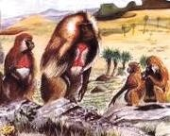
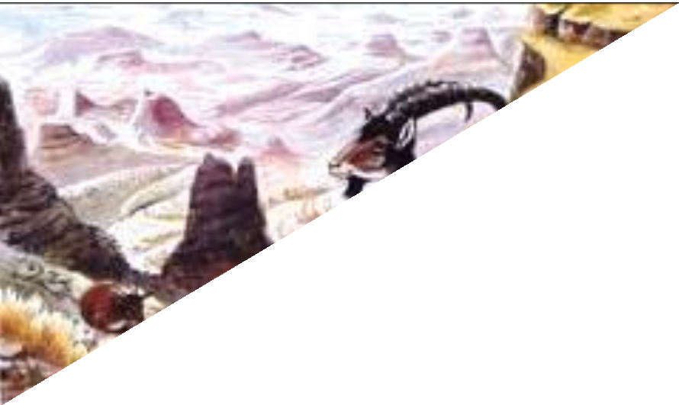
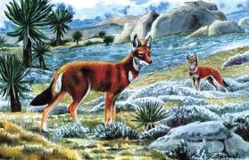
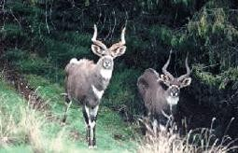

Slide 184
CHAPTER 7
POPULATION OF ETHIOPIA AND THE HORN
Population Data: Uses and Sources
Regular and reliable population data are vital for effective socioeconomic development planning and administration
  are needed to plan for the provision of infrastructures such as schools, hospitals, roads, water and sewerage facilities, housing, establishing voting district boundaries, estimating future tax revenue
There are three conventional sources of obtaining population data:

Slide 185
1) Census:
is the total process of collecting, compiling and publishing demographic, economic and social data pertaining at a specified time
(s) to all persons in a defined territory.
major characteristics:
Universality: inclusion of all persons in a given area during the
count,
  Periodicity: census undertaking at regular time intervals with reference to a defined point of time usually 10 years and 5 years,

Slide 186
Simultaneity: undertaking census in a very limited time duration called the census day/night,
Government sponsorship being an expensive endeavour, and publication
  two procedures for collecting census data:
Dejure approach: it involves counting people according to their usual place of residence (where he/she lives most of the time).
  gives a picture of the total permanent population of an area

Slide 187
b) Defacto approach: Under this approach each individual is recorded at the place where he/she was found at the time of the census.
Sample Survey:
  population/sample/ is selected with the view that information acquired would represent the entire population.
is advantageous over census as costs can be greatly reduced; and it is simple to administer and taken much faster.
sample surveys have the inherent weaknesses related to sampling errors
3) Vital Registration:

Slide 188
is a system of continuous, permanent, compulsory and legal recording of the occurrence and the characteristics of vital events like births, deaths, marriages, divorces, and adoptions.
  more precise than that of census/sample survey and the system provides time series data.
Population Dynamics: Fertility, Mortality and Migration:
population of any particular region (country) grows/declines as a result of the combined effect of the three demographic variables: fertility, mortality and migration.
Ethiopia is endowed with a large and fast-growing population ranking 2nd in Africa after Nigeria

Slide 189

Demographic Measurements:
In Ethiopia, fertility and mortality are the two principal determinants of population growth
1) Crude Birth Rate refers to the number of live births/1000 population
2) General Fertility Rate
women of reproductive age
refers to the total number of live births per

Slide 190


is a relatively specific measure of fertility as it specifically relates births to women in the reproductive age.
3) Total Fertility Rate (T.F.R.) refers to the average number of children that a woman would have at the end of her reproductive period if the current age specific fertility rate remains unchanged.

Slide 191

Where, Bi = Total live births in age group i, W_{i} =Total number of women in age group I (i =age group i.e. 1= 15-19, 2=20-24 3=25- 29, 4 = 30-34, 5 = 35-39, 6=40-44, 7 = 45-49)
4) Crude Death Rate refers to the number of deaths per one thousand population in a year

Slide 192

5) Infant Mortality rate refers to the total number of deaths of infants per one thousand live Birth
6) Maternal Mortality Rate: refers to death of mothers in connection from pregnancy and birth complications per hundred thousand live birth.

Slide 193
7) Life Expectancy at birth: refers to the average number of years that a newly born baby is expected to live.
Life expectancy at birth is greater for urban areas than for rural areas
8) Natural Rate of Increase: is the difference between crude birth rate and crude death rate expressed in percentage
NRI= (C.B.R. - C.D.R.)
Levels and trends in Fertility and Mortality rates in Ethiopia:
Birth and death rates show significant spatiotemporal variation (between rural and urban areas of Ethiopia.)
Urban areas have lower birth and death rates compared to rural areas

Slide 194
Women in rural areas have an average of 5.2 children, compared to 2.3 children among women in urban areas.
regions that have TFR rates more than the national average are Somali (7.2), Afar (5.5), Oromia (5.4), and Tigray (4.7).
  the lowest life expectancy is in Benishangul- Gumuz (47 years) followed by SNNPR (49 years).
birth rates are high due to:
  Little family planning practices and lack of population education
    Early marriage, particularly of females etc.

Slide 195
Country | C.B.R | C.D.R | I.M.R | Life Expectancy (Years)
Ethiopia | 36.5 | 7 | 49.6 | 62.6
Kenya | 23.9 | 6 | 37.1 | 64.3
Somalia | 36.6 | 11 | 94 | 52.8
Eritrea | 29.6 | 7 | 45 | 65.2
Djibouti | 23.4 | 8 | 45.8 | 63.6
Highest Values | Angola/Niger= 44.2 | Lesotho=15.0 | Afghanistan=110 | Monaco=89.4
 | Mali= 43.9 | Lithuania=14.6 | Somalia=94 | Japan=85.3
Lowest Values | Monaco=6.6 | Qatar=1.5 | Monaco=1.8 | Chad=50.6
 | Japan=7.7 | UAE=1.9 | Japan=2 | Guinea Bissau=51.0
Source: Population Reference Bureau, population data sheet, 2017

Slide 196
Countries of the Horn of Africa have higher population growth rate that exceeds 2.6 %.
consequences of this rapid population growth:
low per capita GNP,
increased unemployment and under -employment
continuous inflation that erodes purchasing
currency
power of the
overcrowding of infrastructural and social facilities
Environmental problems such as deforestation, soil erosion, loss of biodiversity

Slide 197


Migration in Ethiopia and the Horn:
  It is an old and inevitable phenomenon
Sex Structure:
Age Structure:
Old Age index:

Slide 198
Population Distribution in Ethiopia:
  is very uneven as a result of physical and human factors
physical factors that affect population distribution include climate, soil, vegetation, drainage and slope
Human factors: the type of economic activity, urbanization, industrialized etc.
Measures of Population Distribution:
  Population Density:
    refers to the number of people per unit area

Slide 199

Crude Density:
  is found by dividing total population to total area.
    does not show variations in population distribution within a given area.
SNNP region has the largest population density (173 people/km²) followed by Amhara region
  Somali, Afar and Benishangul-Gumuz are regions with low densities

Slide 200
Region | Population | Area(km²) | Density(p/km²)
Tigray | 5,247,005 | 84,722 | 61.9
Afar | 1,723,000 | 72,053 | 23.9
Amhara | 20,401,000 | 154,709 | 131.9
Oromia | 33,692,000 | 284,538 | 118.4
Somali | 5,453,000 | 279,252 | 19.5
Benishangul Gumuz | 1,005,000 | 50,699 | 19.8
SNNPR | 18,276,000 | 105,476 | 173.3
Gambella | 409,000 | 29,783 | 13.7
Harari | 232,000 | 334 | 716
Addis Ababa | 3,273,000 | 527 | 6,210
Dire Dawa City Adm. | 440,000 | 1,559 | 282
Total | 90,078,000 | 1,063,652 | 84.7
Source: CSA, Statistical Abstract,2015.

Slide 201


Physiological Density:
  is a ratio between total population and arable part of a country
  Agricultural/rural Density:
which takes only agricultural population as a numerator and cultivated land as a denominator.
gives a better indication of the pressure of population on land resources

Slide 202
Rural population per square kilometer of cropland is the highest for Somali Afar and Gambella.
  is due to the smaller proportion of land that is appropriate for agriculture
The smallest agricultural density lies Amahra (5), Oromia (5.6) and Tigray (5.9).
in Benishangul (3.8),

Slide 203
 |  |  |  |  |  | Age sex Composition
Total population | Total area (Km²) | Arable Land Km² | Rural Pop. | birth | Death | Male | 0-14 | 65+
110,000,000 | 1,106,000 | 6,000,000 | 80% of Tp | 10 million | 5 million | 50 million | 10% of TP | 5% of Tp

Slide 204
Calculate:
the rate of natural increase
The total population of the country at the end of the year if migration has no significant effect
Sex ratio
Age dependency ratio V.Crude density
Dependency ratio
Agricultural Density
physiological density

